Slide 1

IE506: Course Project Endterm Review
Class-Prior Estimation for Learning From Positive And Unlabelled Data
Team Name: Deep Minds-1
Aakash Roy |21i190007
Aayushi Patil| 21i190001
Guide : Prof. Balamurugan Palaniappan
Spring 2023

Slide 2
Content
Problem Description
Work Before Midsem
Major Comments (Midterm Review)
Experiments & Results
Conclusion
References

Slide 3
Before Midterm

Slide 4
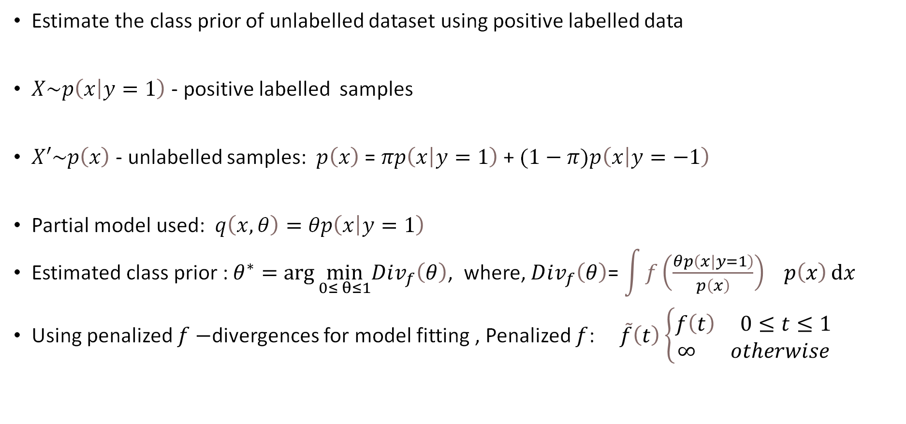
Problem Statement & Setup
Estimate the class prior of unlabelled dataset using positive labelled data
$X\sim p\left(\left.x\right|y=1\right)$ - positive labelled samples
$X′\sim p\left(x\right)$ - unlabelled samples: $p\left(x\right)$ = $πp\left(\left.x\right|y=1\right)$ + $(1−π)p\left(\left.x\right|y=−1\right)$
Partial model used: $q\left(x,θ\right)=θp\left(\left.x\right|y=1\right)$
Estimated class prior : $θ^{∗}=\arg{\min_{0≤ θ≤1}Dⅈv_{f}\left(θ\right)}$, where, $Dⅈv_{f}\left(θ\right)$= $\int{{f\left(\frac{θp\left(\left.x\right|y=1\right)}{p\left(x\right)}\right)}^{}p\left(x\right)ⅆx}$
Using penalized $f−$divergences for model fitting , Penalized $f$: $\tilde{f}\left(t\right)\left\{\begin{matrix}f\left(t\right) 0≤t≤1 \\ ∞ otherwise\end{matrix}\right.$

Slide 5
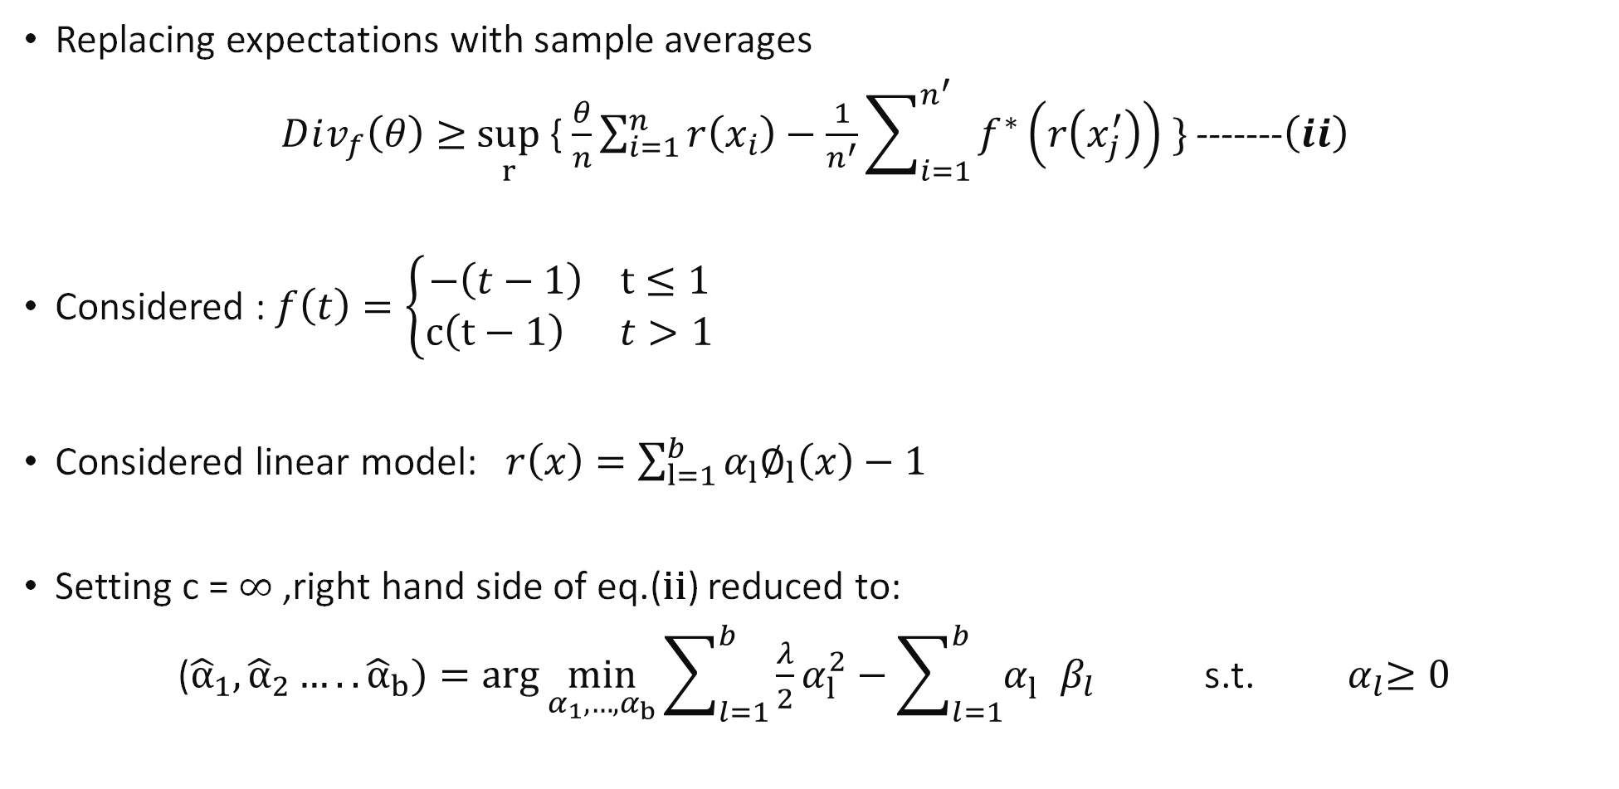
Solution Approach
Replacing expectations with sample averages
$Dⅈv_{f}\left(θ\right)≥$ $\sup_{r}$ { $\frac{θ}{n}\sum_{i=1}^{n^{}}{r\left(x_{i}\right)}−\frac{1}{n^{′}}\sum_{i=1}^{n^{′}}{f^{∗}\left(r\left(x_{j}^{′}\right)\right)} \}$ -------$\left(ⅈi\right)$
Considered : $f\left(t\right)=\left\{\begin{matrix}−\left(t−1\right) t≤1 \\ c\left(t−1\right) t>1\end{matrix}\right.$
Considered linear model: $r\left(x\right)=\sum_{l=1}^{b}{α_{l}∅_{l}\left(x\right)}−1$
Setting c = $∞$ ,right hand side of eq.(ii) reduced to:
(${\hat{α}}_{1},{\hat{α}}_{2}…..{\hat{α}}_{b})=\arg{\min_{α_{1},…{,α}_{b}}}\sum_{l=1}^{b}{\frac{λ}{2}α_{l}^{2}}−\sum_{l=1}^{b}{α_{l}^{}β_{l}}$s.t. ${ α}_{l}≥0$

Slide 6
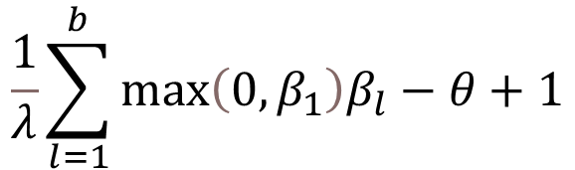
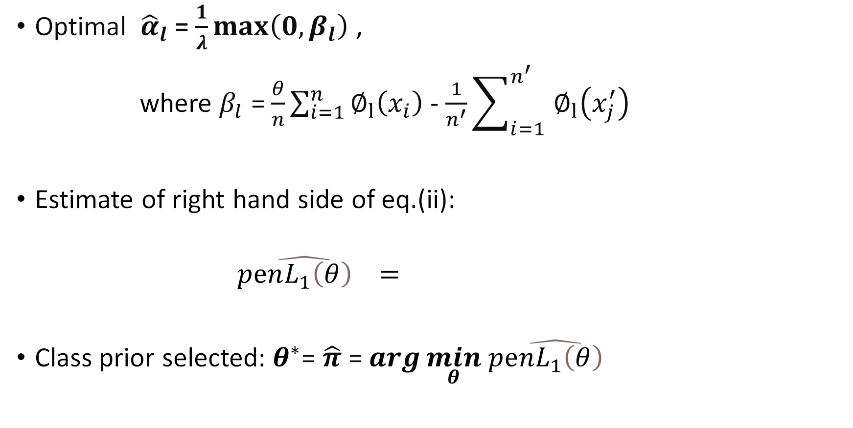
Solution Approach Continued…
Optimal ${\hat{α}}_{l}$ = $\frac{1}{λ}\max\left(0,β_{l}\right)$ ,
where $β_{l}$ = $\frac{θ}{n}\sum_{i=1}^{n^{}}{∅_{l}\left(x_{i}\right)}$ - $\frac{1}{n^{′}}\sum_{i=1}^{{n^{′}}^{}}{∅_{l}\left(x_{j}^{′}\right)}$
Estimate of right hand side of eq.(ii):
$\hat{pⅇnL_{1}\left(θ\right) }=$
Class prior selected: $θ^{∗}$= $\hat{π}$ = $\arg{\min_{θ}}$ $\hat{pⅇnL_{1}\left(θ\right) }$

Slide 7
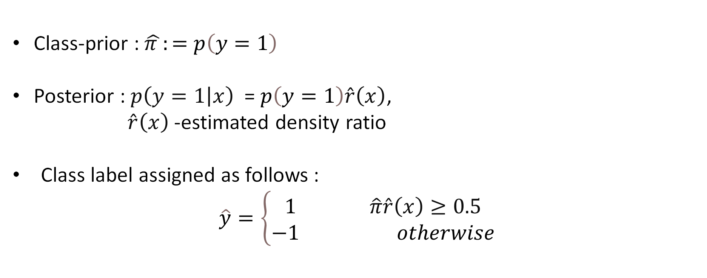
Solution Approach Continued…
Class-prior : $\hat{π }:=$ $p\left(y=1\right)$
Posterior : $p\left(\left.y=1\right|x\right)$ = $p\left(y=1\right)\hat{r}\left(x\right)$,
$\hat{r}\left(x\right)$-estimated density ratio
Class label assigned as follows :
$$\hat{y}=\left\{\begin{matrix}1 \hat{π}\hat{r}\left(x\right)≥0.5 \\ −1 otherwise\end{matrix}\right.$$

Slide 8
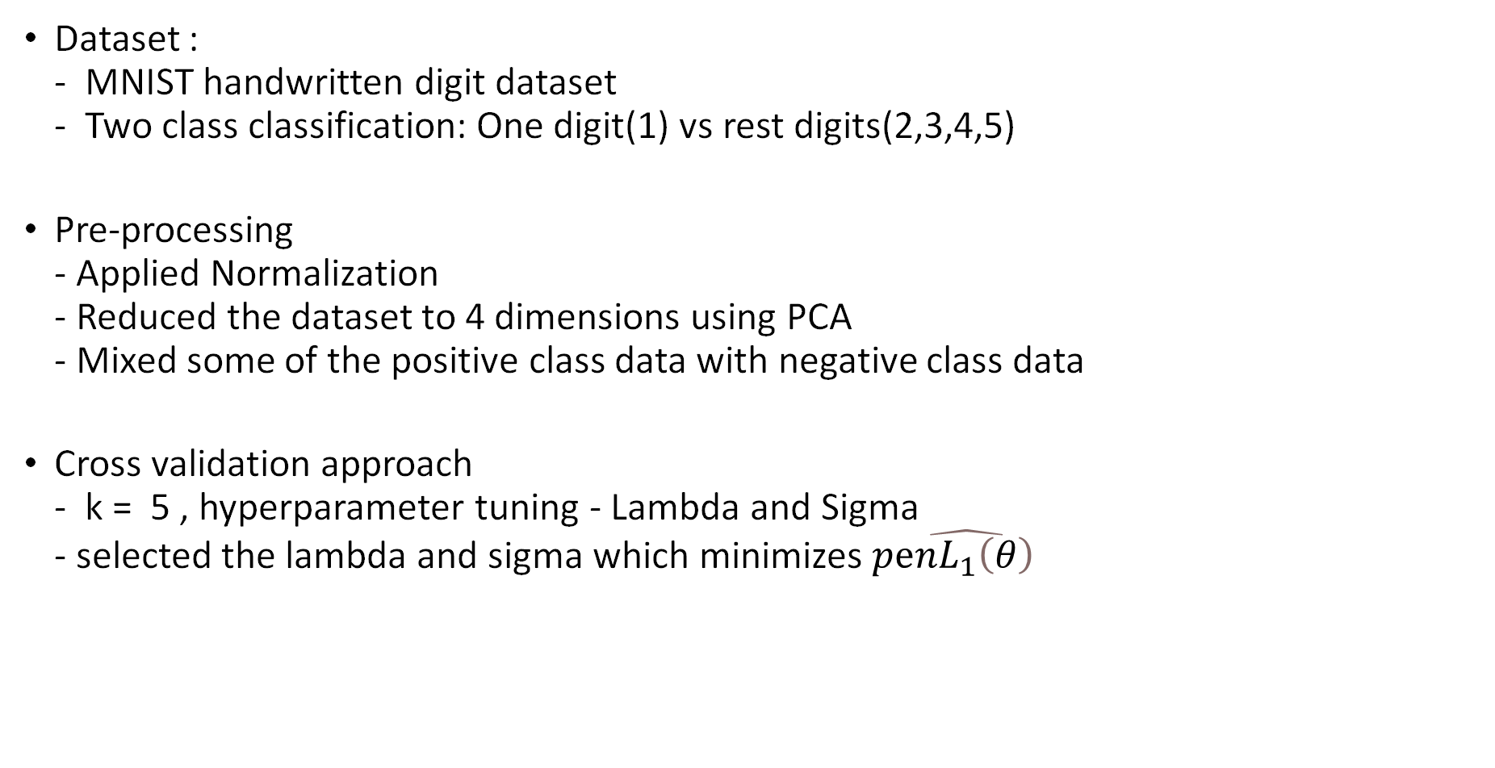
Experiment Setup
Dataset : - MNIST handwritten digit dataset - Two class classification: One digit(1) vs rest digits(2,3,4,5)
Pre-processing - Applied Normalization - Reduced the dataset to 4 dimensions using PCA - Mixed some of the positive class data with negative class data
Cross validation approach - k = 5 , hyperparameter tuning - Lambda and Sigma - selected the lambda and sigma which minimizes $\hat{pⅇnL_{1}\left(θ\right) }$

Slide 9
Experimental Work Done By The Team
Initial Experiment Setup - Number of samples for training – 400 - 80% Training, 20% Testing - Proportion of positive labelled data as 0.375, and the accuracy achieved was around 40%.
Status of the experiments - Number of samples for training - 2000 - 80% Training, 20% Testing
Proportion of positive Class Data | Lambda | Sigma | Accuracy
0.2 | 0.001 | 8.433 | 76.501
0.4 | 0.001 | 8.433 | 60.001
0.6 | 0.001 | 8.433 | 39.991
0.8 | 0.001 | 8.433 | 19.975

Slide 10
Mid-term Review Comments
Implement the code correctly & improve results
Try to add some noise to the input data & compare results

Slide 11
After Midsem

Slide 12
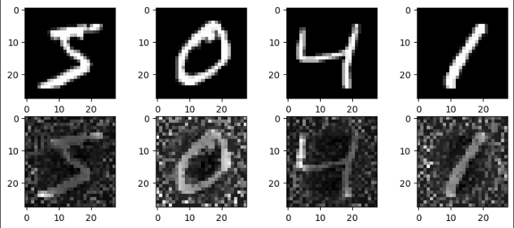
Data Collection & Setup
Dataset : - MNIST handwritten digit dataset using Torch/Keras - Two class classification: One digit(1) vs rest digits(2,3,4,5) - Added Gaussian noise (mean = 20, standard deviation = 40) to the training set by generating a matrix of random values with the same shape as the training set and adding it to the original images - Clipped the pixel values to the range [0, 255] to ensure that they remain within the valid range of grayscale values - Normalized the data and applied PCA to reduce it to 4 attributes (Earlier 28 X 28 attributes)
Without Noise
With Noise

Slide 13
Experiment Setup
No. Of Training Sample: 2000
Sigma Values: Without Noise: [ 1.20476081 10.84284733 20.48093385 30.11902037] With Noise: [ 1.36887136 12.31984221 23.27081307 34.22178393]
Lambda Values: 0.1, 1, 10, 100
No. Of Cross Validation: 5
Prior Values: 0.2, 0.4, 0.6, 0.8

Slide 14
Results Without Noise
True Class Prior | Estimated Class prior | Lambda | Sigma | Accuracy(%)
0.2 | 0.2 | 0.1 | 10.843 | 81.25
0.4 | 0.4 | 0.1 | 1.205 | 84.25
0.6 | 0.6 | 0.1 | 1.205 | 62.5
0.8 | 0.6 | 0.1 | 1.205 | 50.0

Slide 15
Results With Noise
True Class Prior | Estimated Class prior | Lambda | Sigma | Accuracy(%)
0.2 | 0.2 | 0.1 | 11.299 | 81.25
0.4 | 0.2 | 0.1 | 1.3688 | 83.33
0.6 | 0.2 | 0.1 | 12.3198 | 75.0
0.8 | 0.6 | 0.1 | 1.205 | 50.0

Slide 16
Conclusion
Without Noise: - The accuracy was highest for the true class prior value 0.4 - All the estimated class prior was same with the true class prior for all except 0.8 - More accurate class prior results in better accuracy
With Noise: - The accuracy was highest for the true class prior value 0.4 - All the estimated class prior was different from the true class prior for all except for 0.2 - All the accuracy was a bit less compared to the without noise data

Slide 17
References
M. C. du Plessis, G. Niu, and M. Sugiyama. Analysis of learning from positive and unlabeled data. In Z. Ghahramani, M. Welling, C. Cortes, N. D. Lawrence, and K. Q. Weinberger, editors, Advances in Neural Information Processing Systems 27, pages 703–711, 2014.
M. C. du Plessis and M. Sugiyama. Semi-supervised learning of class balance under class-prior change by distribution matching. In ICML 2012, pages 823– 830, Jun. 26–Jul. 1 2012.
Christoffel, Marthinus, Gang Niu, and Masashi Sugiyama. "Class-prior estimation for learning from positive and unlabeled data." Asian Conference on Machine Learning. PMLR, 2016.
GitHub_Code_Repository

Slide 18
THANK YOU !!

